Slide 1
AWS LOOKOUT FOR VISION

Slide 2
Look Out For Vision:
Amazon Lookout for Vision is a machine learning service provided by Amazon Web Services (AWS) that helps you identify defects and anomalies in images for industrial applications.
It uses computer vision and machine learning algorithms to automatically analyze images and detect anomalies or quality issues in manufacturing processes, visual inspections, and product defects.

Slide 3
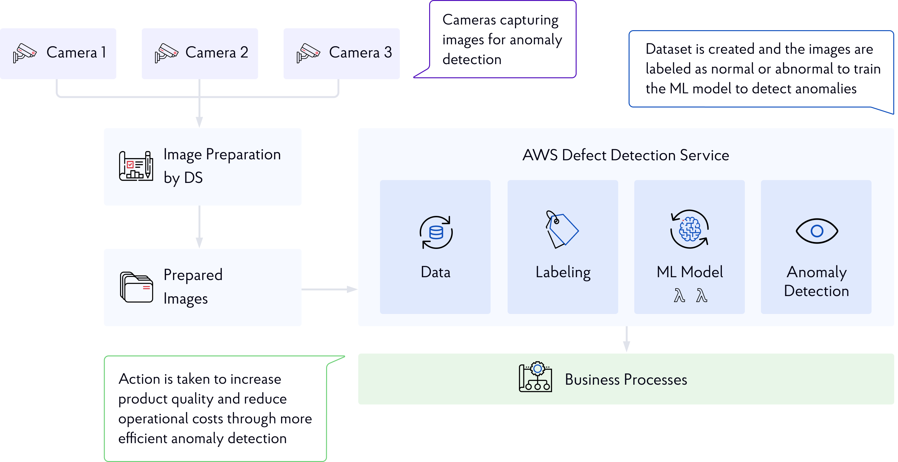

Slide 4
Implementation steps:
Step1: Create a S3 Bucket
Step2: Create a Project
Step3: Upload images and Label Dataset
Step4: Train the model
Step5: Evaluate Performance Metrics
Step6: Run Trail Detection
Step7: Retrain the model
Step8: Delete AWS Resources

Slide 5
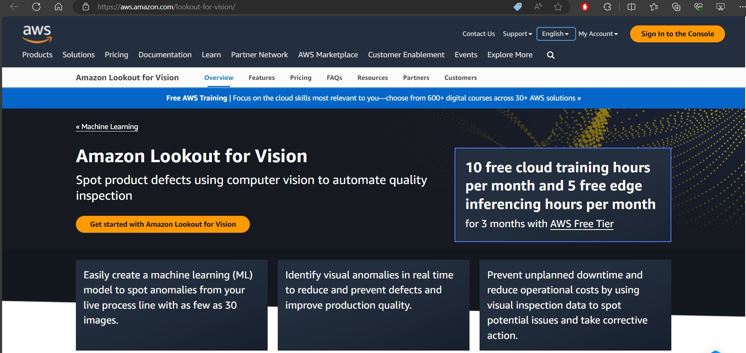

Slide 6
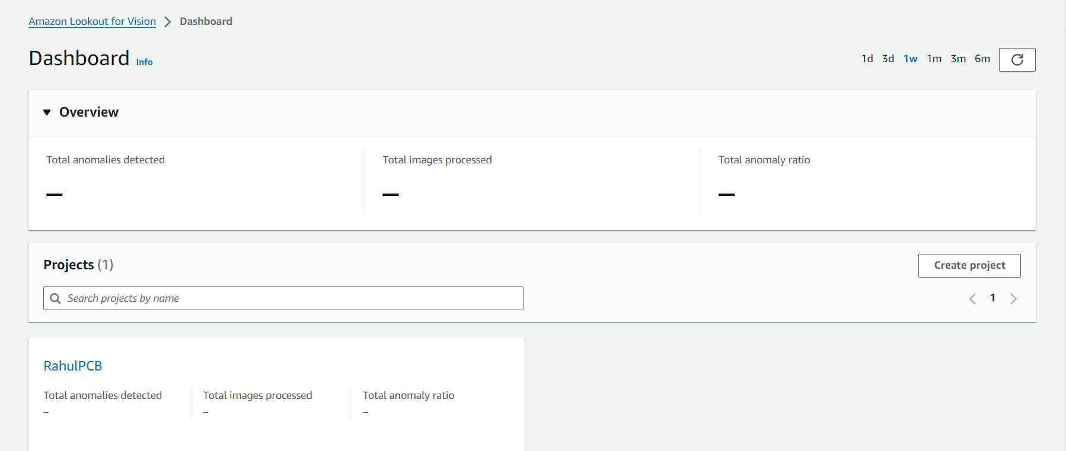

Slide 7
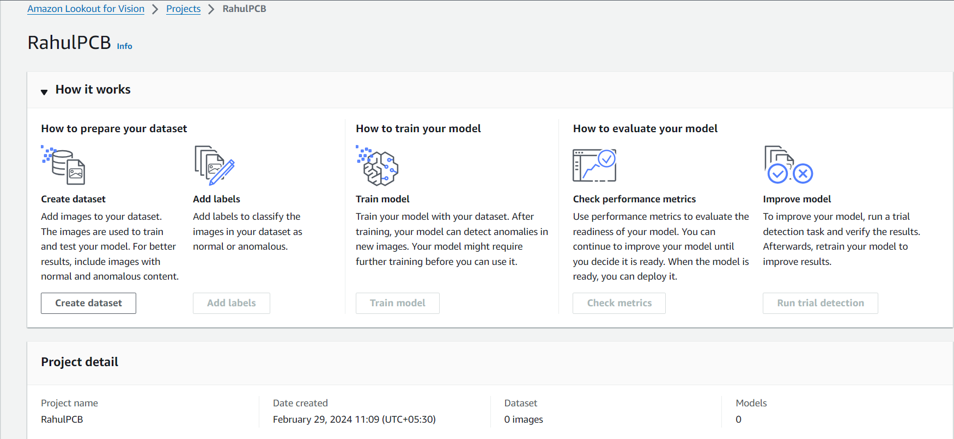

Slide 8
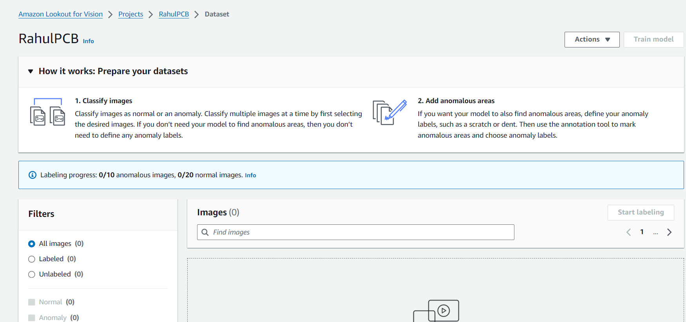
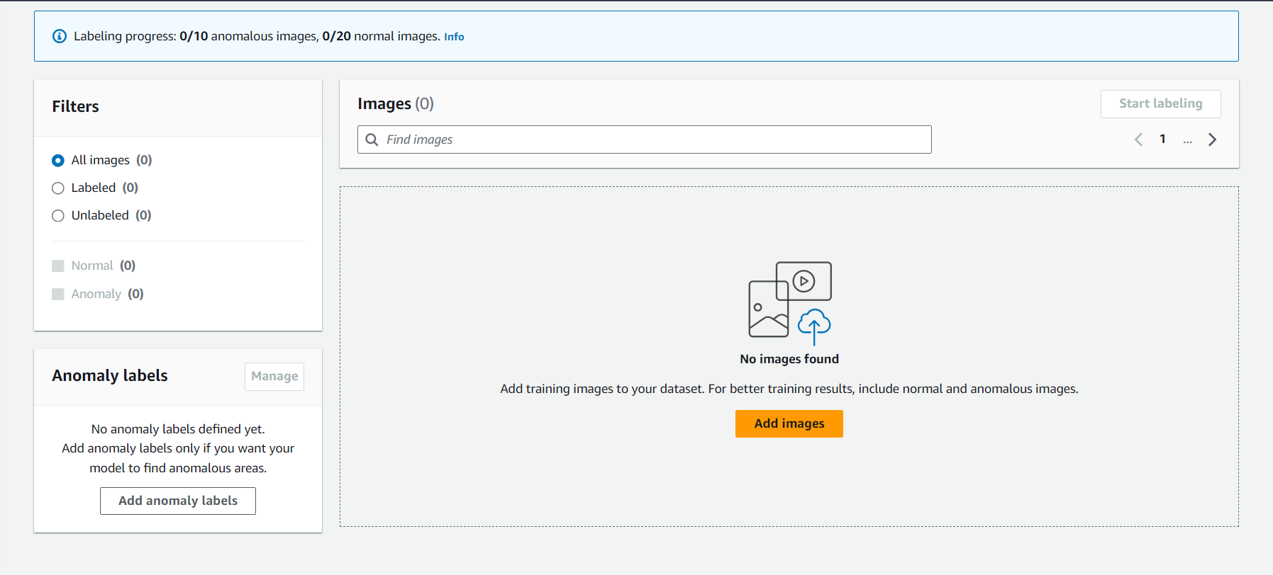

Slide 9
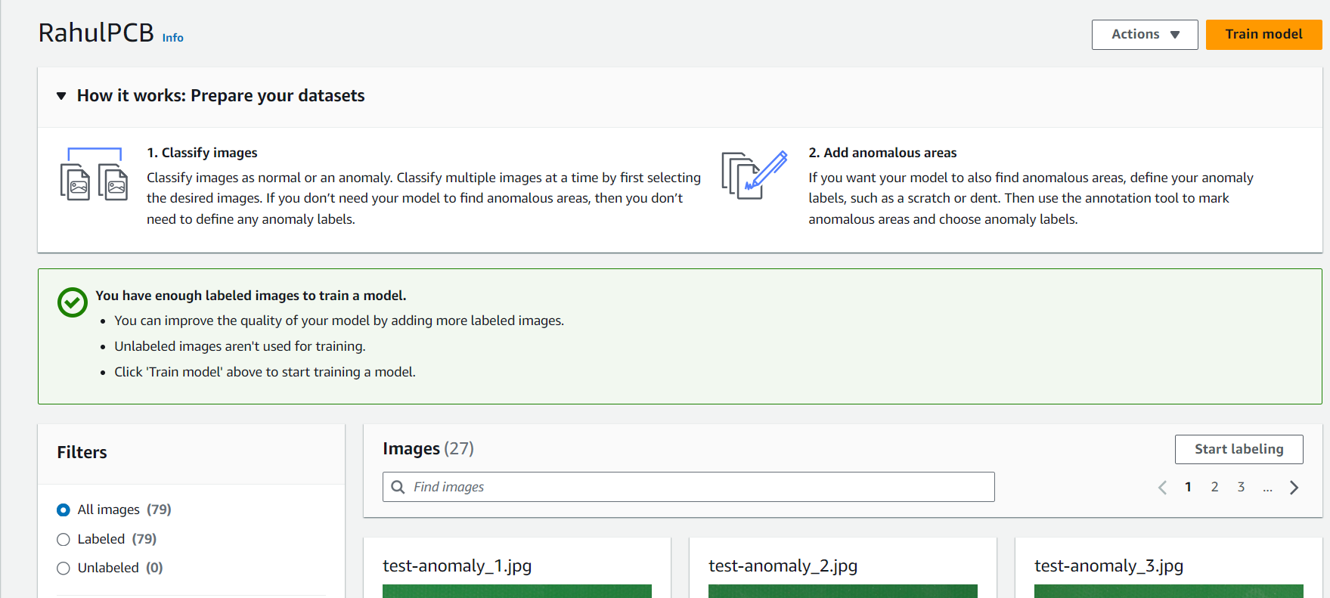

Slide 10
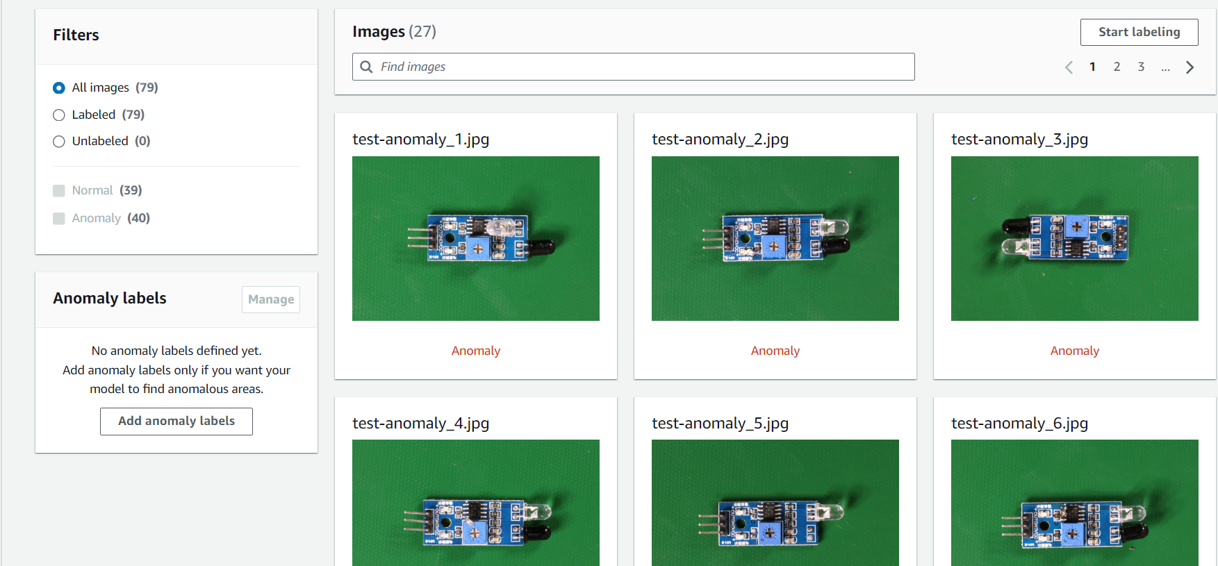

Slide 11
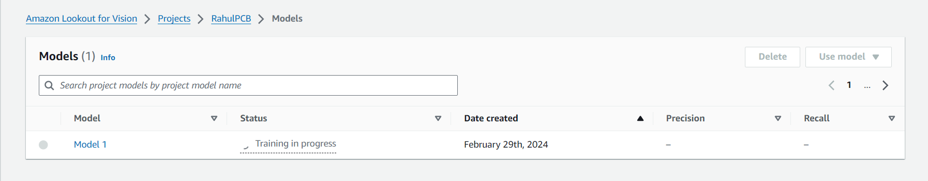

Slide 12
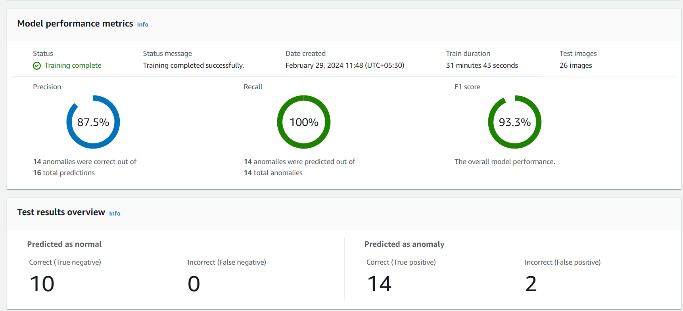

Slide 13
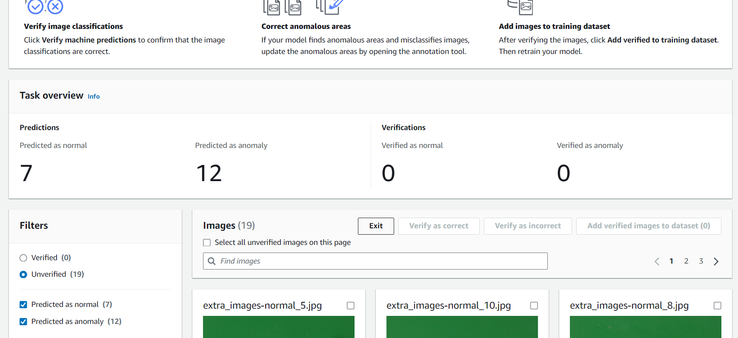

Slide 14
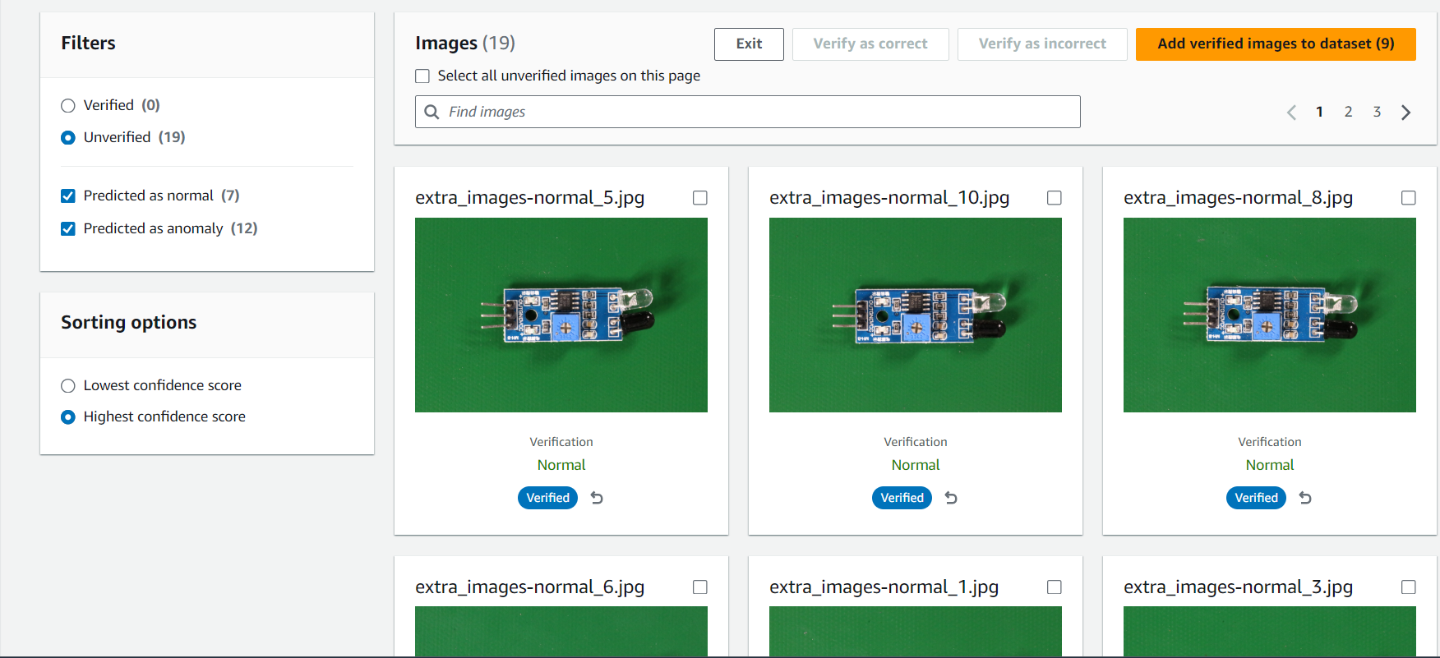

Slide 15
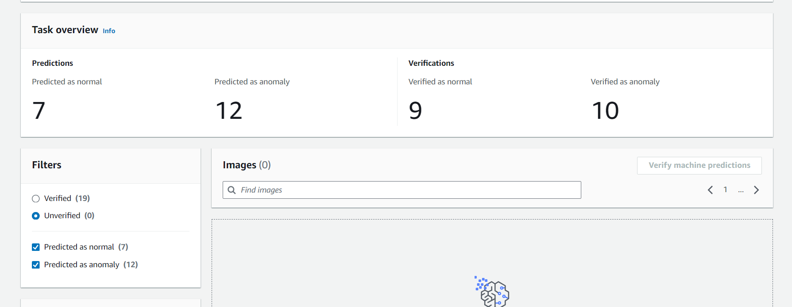

Slide 16
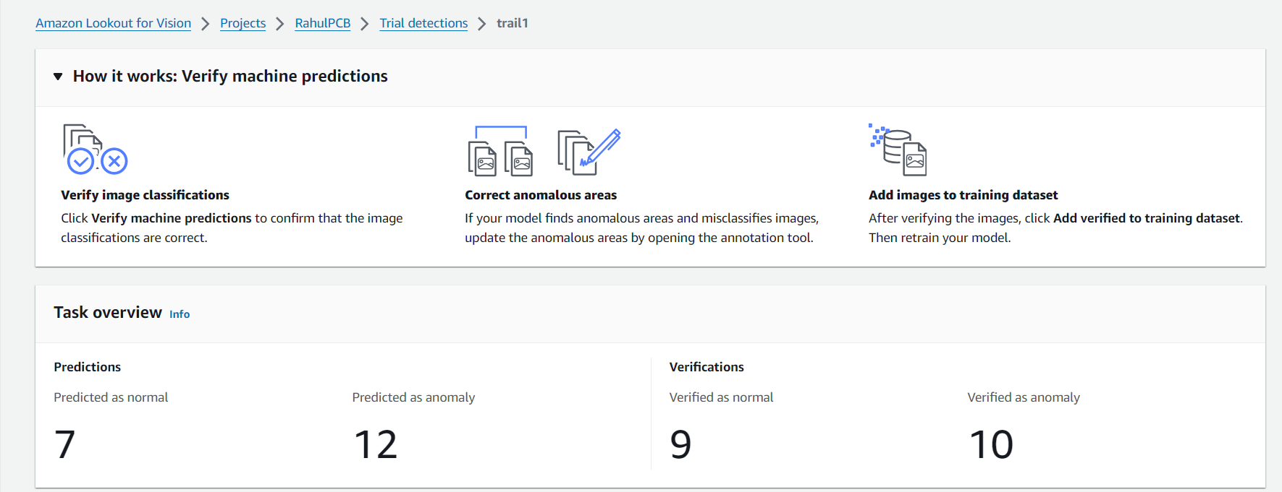

Slide 17
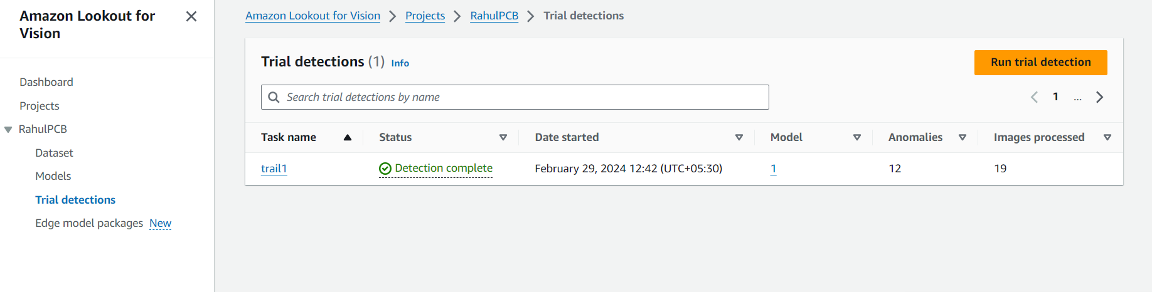

Slide 18
THANK YOU

